Slide 1
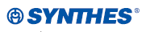
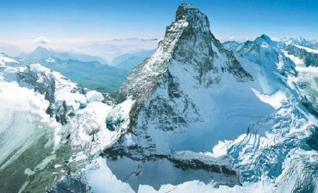
Synthes – Proof of Concept
August 9th and 10th, 2007
Notes:
SAP Issues:
*apparently even today they have multiple disparate systems. Excel is at least one of these. Some others may be systems. They show pep PDM (sap PLM) as a future target
*5 c’s of an xApp – Composite, collaborative, content, cross functional, closed loop
Complexity to maintain is getting higher. Many of the SAP components must be separate servers that are separately maintains
Implementing full suite of SAPs full product suite requires 13 servers
Client/Server

Slide 2
User Definition and Rights
Show how new users are created
Show how roles (a set of access privileges) are created
Show how roles are assigned to users
Show the password reset functionality and how access to that function
can be assigned to administrators
Show how access rights can be restricted on the object types (e.g. documents,
parts, projects etc) as well as subtypes (access rights for different document types).
Explain and/or show how administrators can be temporarily assigned rights to edit
data fields which are generally locked.

Slide 3
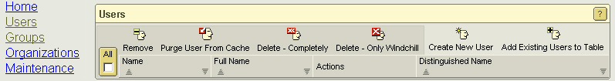
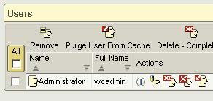
User Definition and Rights
Show how new users are created
Select ‘Users’ link and ‘Create New User’ icon
‘Add existing User to Table’ icon should be used to view and update existing users

Slide 4
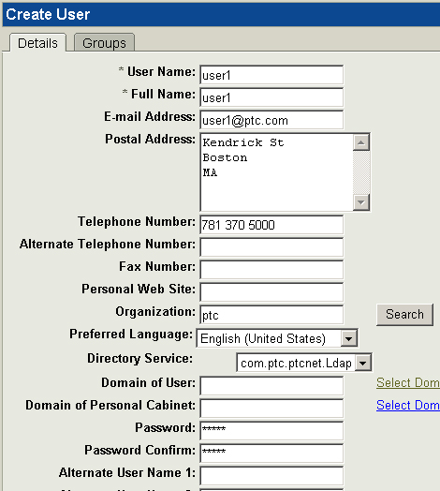
User Definition and Rights
Show how new users are created
Define:
Unique Username
Full Name
Email address
Postal Address / Tel
Organization
Preferred Language
User Personal Cabinet Domain
Password
Alternate User Names

Slide 5
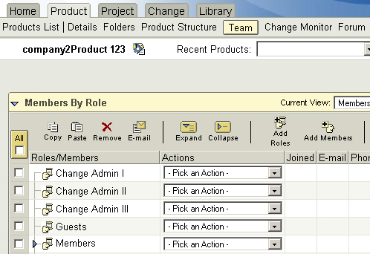
User Definition and Rights
Show how roles (a set of access privileges) are created
Review default container Team Roles and associated Access Policies
If default Roles and access policies suitable, assign appropriate users to the various roles
If default Roles and access policies not suitable, review with Organization Administrator
Modify existing Rules
Add new Roles with suitable Domain based access policies

Slide 6
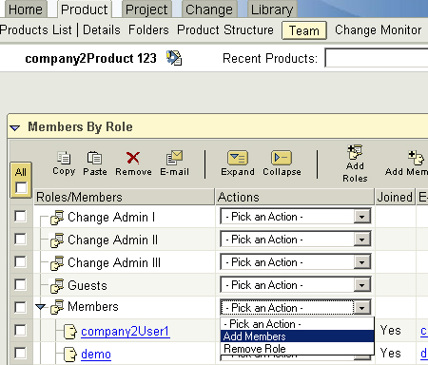
User Definition and Rights
Show how roles are assigned to users
Set up Product Team:
Login as Product Manager and set up the Team
Add Users to existing Roles defined by Product context template
Define Roles as required (Consider Access Policies, OIR’s etc)
Add Users to existing/new roles

Slide 7
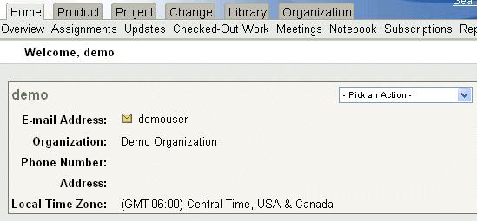
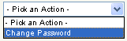
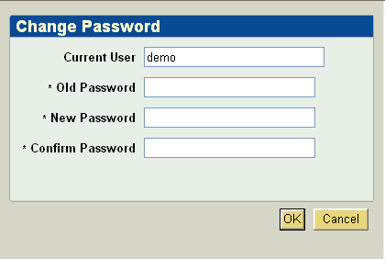
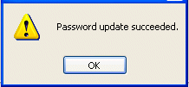
User Definition and Rights
Show the password reset functionality
Allows users to change their passwords by selecting a utility available from the Utilities page of the Home tab

Slide 8
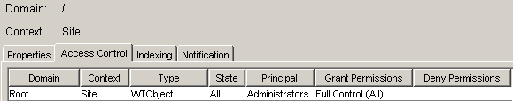
User Definition and Rights
Show how access rights can be restricted on the object types (e.g. documents, parts, projects etc) as well as subtypes (access rights for different document types).
Administration Policies
Access Control Rules
Define who can access specific objects types, when they are accessed and what actions can be performed
Configure Object Type, Lifecycle State, Principal, Permissions (Grant/Deny)

Slide 9
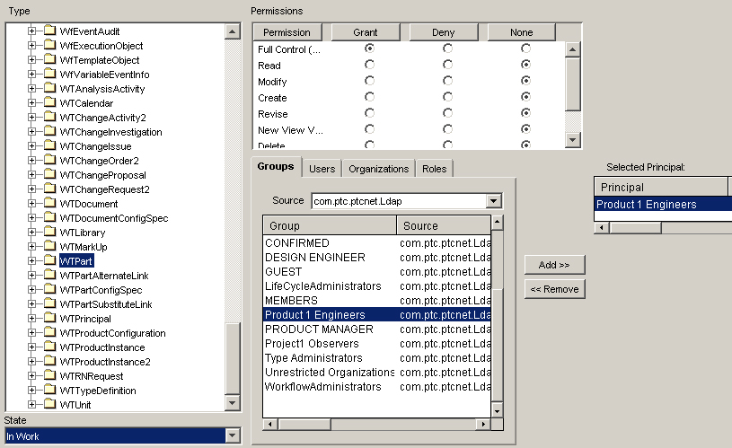
User Definition and Rights
Show how access rights can be restricted on the object types (e.g. documents, parts, projects etc) as well as subtypes (access rights for different document types).
Example – Configure Access Control Rule
Steps:
Define Access Rule using PTC Product1 Engineers pseudo group as Principal
WTPart, In Work, Full Control
Select Type (WTPart)
Select Lifecycle State (In Work)
Select Permissions
Search for and Select Principal

Slide 10
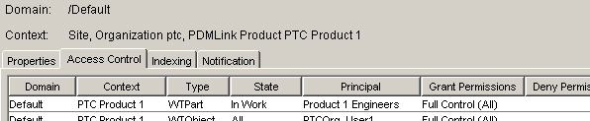
User Definition and Rights
Show how access rights can be restricted on the object types (e.g. documents, parts, projects etc) as well as subtypes (access rights for different document types).
Review Access Rule:

Slide 11
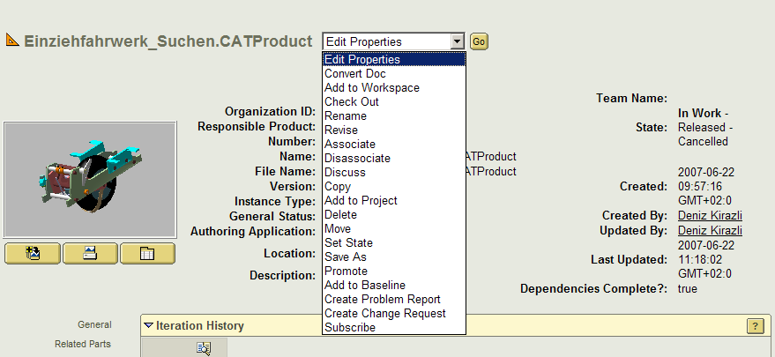
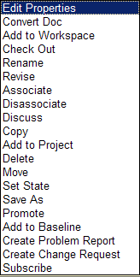
User Definition and Rights
Explain and/or show how administrators can be temporarily assigned rights to edit data fields which are generally locked
User with extended rights
Windchill provides the possibility to define access
controls for each induvidual, roles or groups.

Slide 12
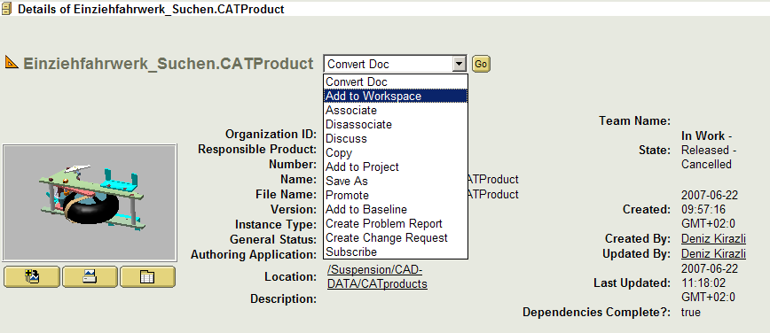
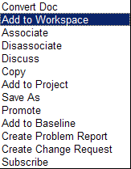
User Definition and Rights
Explain and/or show how administrators can be temporarily assigned rights to edit data fields which are generally locked
User with limited rights

Slide 13
Customizing
Show how a new data field can be defined and the properties which can be
assigned to the field.
Show how a new function is created and how that function is assigned to a an
object type (e.g. a function which is applied to a part by pressing a button)
Explain and/or show how customizing is transported from a development to
integration and production environment

Slide 14
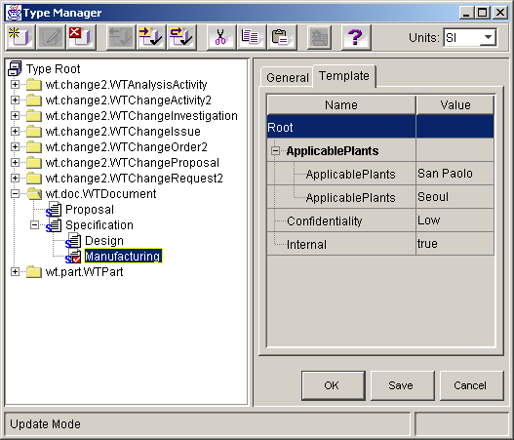
Customizing – Type Manager
Show how a new data field can be defined and the properties which can be assigned to the field.
Allows Dynamic Definition of Custom Data Types Through Graphical Interface “On-the-fly” at Runtime
Type Hierarchy
Type Properties
Type-based Attributes
Customer Specific Types
Type Checked Out for Modification
Default Attribute Values
Notes:
The Type Manager allows dynamic definition (and redefinition) of custom data types “on the fly” via a graphical user interface – at runtime, i.e. while the system is running and without any server downtime, restart, compilation, or database schema change.
Relevant features include a hierarchical view of the dynamic types. This allows the customer (or implementation team) to quickly create, view, and modify a hierarchy of types specific to their business needs.
From this hierarchical view, one can check out a type for modification. It is worth noting that the types are version controlled Windchill objects. This means that the administrator can modify a private copy of one or more types over some period of time before committing the changes so that they affect system operation. Upon such a commit, objects of affected types are seamlessly, automatically (and lazily) migrated. [It is also worth noting that the Types are access controlled and thus administrators can be given privileges to modify some types and not others.]
In the right half of the window, is the type properties panel. The contents of this panel reflect the type currently selected in the type hierarchy panel. The type properties panel allows viewing of the properties (name, description, icon, etc) and attributes of a type and the modification of these for types which the user has checked out. The administrator can add, modify, and view additional attributes (beyond those intrinsic in the base object, e.g. a Windchill document) by adding them in the Template tab of the type properties panel. [Attributes of a type are present in all objects of the given type.] The administrator can also establish default values (including multiple values) for these attributes. Though not shown on this slide, the administrator can also add constraints to these attributes as well (e.g. single vs. multi-valued, immutability, allowable value sets or ranges, etc).
Again, all of this can be done without hindering ongoing production operation of the system.

Slide 15
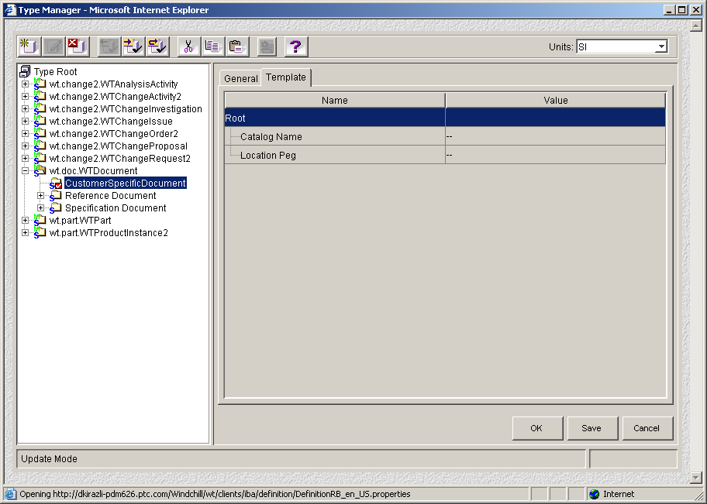
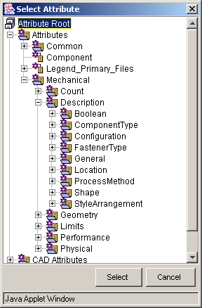
Customizing – Type Manager
Show how a new data field can be defined and the properties which can be assigned to the field.
Add Attributes:
Ease of use, all kinds of attributes are possible and you are also able to define constrains, e.g. attribute catalog restricted to a certain selection list.
The attribute is automatically integrated in the standard userinterface
No Customization is required

Slide 16
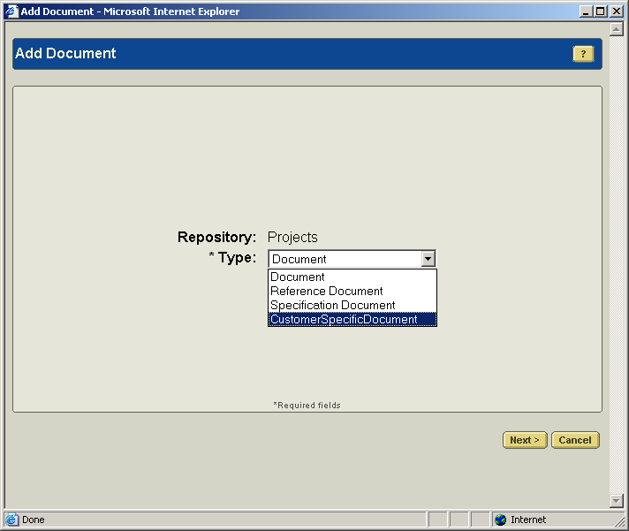
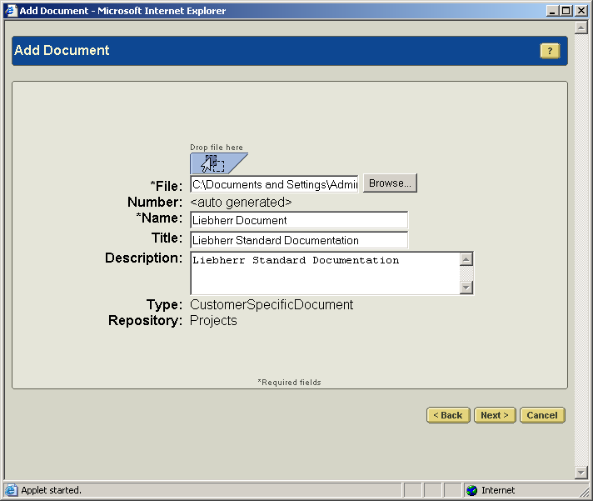
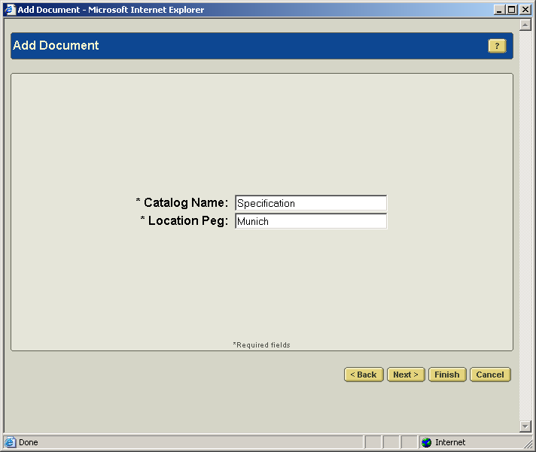
Customizing – Type Manager
Show how a new data field can be defined and the properties which can be assigned to the field.
Create new document:
the attributes (catalog name, location peg) are automatically integrated in the UI.

Slide 17
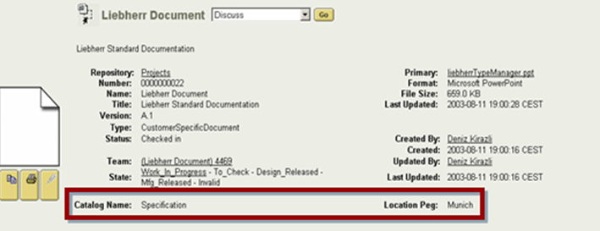
Customizing – Type Manager
Show how a new data field can be defined and the properties which can be assigned to the field.
Interface for the new attributes:
Automatically updated interface.
No Customization is required

Slide 18
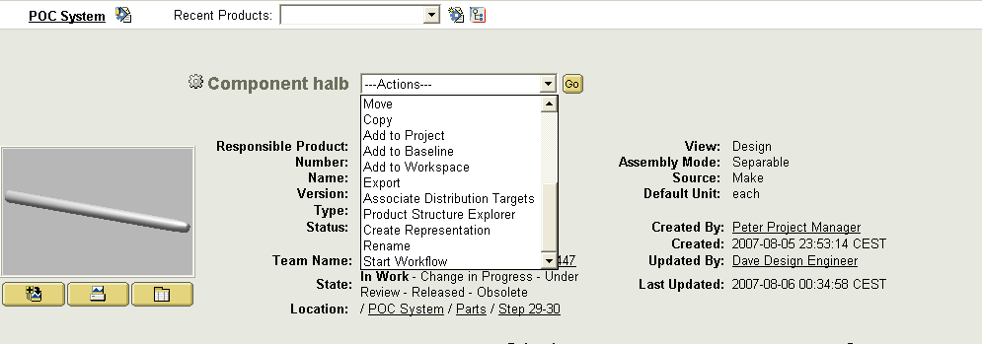
Customizing
Show how a new function is created and how that function is assigned to a an object type (e.g. a function which is applied to a part by pressing a button).
Adding a new function
in the Action Menú
Notes:
The Type Manager allows dynamic definition (and redefinition) of custom data types “on the fly” via a graphical user interface – at runtime, i.e. while the system is running and without any server downtime, restart, compilation, or database schema change.
Relevant features include a hierarchical view of the dynamic types. This allows the customer (or implementation team) to quickly create, view, and modify a hierarchy of types specific to their business needs.
From this hierarchical view, one can check out a type for modification. It is worth noting that the types are version controlled Windchill objects. This means that the administrator can modify a private copy of one or more types over some period of time before committing the changes so that they affect system operation. Upon such a commit, objects of affected types are seamlessly, automatically (and lazily) migrated. [It is also worth noting that the Types are access controlled and thus administrators can be given privileges to modify some types and not others.]
In the right half of the window, is the type properties panel. The contents of this panel reflect the type currently selected in the type hierarchy panel. The type properties panel allows viewing of the properties (name, description, icon, etc) and attributes of a type and the modification of these for types which the user has checked out. The administrator can add, modify, and view additional attributes (beyond those intrinsic in the base object, e.g. a Windchill document) by adding them in the Template tab of the type properties panel. [Attributes of a type are present in all objects of the given type.] The administrator can also establish default values (including multiple values) for these attributes. Though not shown on this slide, the administrator can also add constraints to these attributes as well (e.g. single vs. multi-valued, immutability, allowable value sets or ranges, etc).
Again, all of this can be done without hindering ongoing production operation of the system.

Slide 19
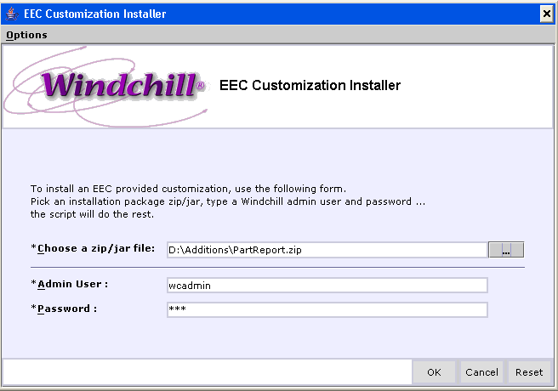
Customizing
Explain and/or show how customizing is transported from a development to integration and production environment
With the customization installer it is easy to transport the environment
Notes:
The Type Manager allows dynamic definition (and redefinition) of custom data types “on the fly” via a graphical user interface – at runtime, i.e. while the system is running and without any server downtime, restart, compilation, or database schema change.
Relevant features include a hierarchical view of the dynamic types. This allows the customer (or implementation team) to quickly create, view, and modify a hierarchy of types specific to their business needs.
From this hierarchical view, one can check out a type for modification. It is worth noting that the types are version controlled Windchill objects. This means that the administrator can modify a private copy of one or more types over some period of time before committing the changes so that they affect system operation. Upon such a commit, objects of affected types are seamlessly, automatically (and lazily) migrated. [It is also worth noting that the Types are access controlled and thus administrators can be given privileges to modify some types and not others.]
In the right half of the window, is the type properties panel. The contents of this panel reflect the type currently selected in the type hierarchy panel. The type properties panel allows viewing of the properties (name, description, icon, etc) and attributes of a type and the modification of these for types which the user has checked out. The administrator can add, modify, and view additional attributes (beyond those intrinsic in the base object, e.g. a Windchill document) by adding them in the Template tab of the type properties panel. [Attributes of a type are present in all objects of the given type.] The administrator can also establish default values (including multiple values) for these attributes. Though not shown on this slide, the administrator can also add constraints to these attributes as well (e.g. single vs. multi-valued, immutability, allowable value sets or ranges, etc).
Again, all of this can be done without hindering ongoing production operation of the system.

Slide 20
Data Security
Explain the mechanism how data is protected from unintentional as well as
intentional modification by system administrators (e.g. trash bin, encrypted
file names etc)

Slide 21
Data Security
Explain the mechanism how data is protected from unintentional as well as intentional modification by system administrators (e.g. trash bin, encrypted file names etc)
Who (Principal)
What (Object Type)
When (LC state)
Where (Domain)
How (Permissions)
INHERITANCE
Container Hierarchy
General Domain Hierarchy
\ Root
Site
Site (System, Default, User, SessionIteratedDomain)
Org1
Organization: Org1 (System, Default, Private, User)
Library1
Library: Library1 (System, Default)
Folder
Notes:
Root
Sets rules that govern the entire enterprise
System
Serves as the default domain for most system administration objects, including queues and life cycle, definitions. System is the default domain of the Administrators group. The System domain is not intended for general user business objects.
Default
Serves as the default domain for other business information objects
Private
Serves as the default parent domain for Application Container System Domains and Private Access Default Domains
User
Serves as the default domain for organization objects (WTOrganization)
Is also the parent domain for the Unaffiliated domain and for organization container domains that hold the users (and their personal cabinets) for that organization (Needed when a user who does not have an Organization affiliation accesses the system)
CAD Workspaces are stored in the User domain as Folders
SessionIteratedDomain
Serves as the default domain for internal session processes. Do not modify the policies set for this domain

Slide 22
Data Security
Explain the mechanism how data is protected from unintentional as well as intentional modification by system administrators (e.g. trash bin, encrypted file names etc)
If there is no access control rule, the principal is denied access to the object.
If a Grant permission and a Deny permission is defined for the same principal, object type and life cycle state, the Deny permission takes precedent.
Net group permissions (including Grant and Deny permissions) are the union of all permissions for each group and Organization to which the user account belongs.
Permissions Granted or Denied explicitly to a user always override group permissions.

Slide 23
Backup
Explain the backup concept for user data, files and system data. Show how
it is possible to implement this with standard backup/restore tools

Slide 24
Backup
Explain the backup concept for user data, files and system data. Show how it is possible to implement this with standard backup/restore tools
How much data loss is acceptable in a recovery scenario?
What is the mean time between failures for the Data Server hardware?
How much is budgeted for backup hardware/software, or are the existing systems adequate?
What is the maximum time allowable for recovery?
How much time can the administrator spend maintaining the backups?
Is the administrator a properly trained Oracle DBA who can maintain an archive log backup strategy?

Slide 25

Backup
Explain the backup concept for user data, files and system data. Show how it is possible to implement this with standard backup/restore tools
Hot backups are done when the system is online
No downtime
More prone to errors since they rely on processes and specific procedures
Can be incremental or full backups
Cold backups are done when the system is offline
Best type if you can afford downtime
Quicker and cleaner to restore because information is not incremental
There are 2 Types of Windchill Data Stores
Primary: contain information that cannot be rebuilt and therefore MUST be backed up
Oracle
File Vaults
Content Cache Vaults
LDAP Information (Aphelion)
Secondary: can be backed up, restored, or rebuilt
FastSearch Indices
Replicated Vaults
More Infos

Slide 26
Backup - Example on our ProjectLink Server:
Explain the backup concept for user data, files and system data. Show how it is possible to implement this with standard backup/restore tools
Backup Example on our ProjectLink Server:
Database Server:
Hot Backup twice a week
Cold backup on Maintenance weekend
Oracle Archive Logs for the delta.
Windchill Server
Backup Schedule for the Windchill Application files, including the Aphelion Database.
Differential: Everyday (this covers anything that have changed since the last differential)
Accumulative: Every 5 days (this covers anything that have changed since the last full backup)
Full: Every 18 Days.
Recovery Example on our ProjectLink Server :
Database Server:
Fail Over Database Cluster Environment.
RAID 5 Disk configuration gives up the ability to recover from a single disk failure.
We can restore from Hot/Cold backup and use the Archive Logs for the delta.
Windchill Server
RAID 5 Disk configuration gives up the ability to recover from a single disk failure.
In case of total disk failure, we can restore from tape.

Slide 27
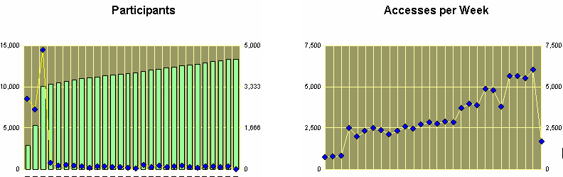
Backup - Example on our ProjectLink Server:
PTC PDS has been available to PTC users since July, 2001
34,394+ unique participants
Over 10,241 projects
Over 1299389 files
Database size: 3.1 TB

Slide 28
Recovery
Explain and/or show how a new instance of a fully functional system can be
installed in a disaster recovery process.
Explain how different instances of the system can be reconciliated (e.g. integration
environment is made equal to production environment.

Slide 29
Recovery
Explain and/or show how a new instance of a fully functional system can be installed in a disaster recovery process. Explain how different instances of the system can be reconciliated (e.g. integration environment is made equal to production environment.
Timing in the restore is crucial to making sure that everything on the system is in synch with each other.
Each component has to be restored to the same point and time so that they are as close as possible
Some manual steps may be required to completely resolve the recovery point
E.g. If Oracle is recovered to 14:30, you will have to confirm that the external vaults only contain files that are listed in the FVItem table (the names are hashed on disk using a dectohex function!)

Slide 30
Recovery
Explain and/or show how a new instance of a fully functional system can be installed in a disaster recovery process. Explain how different instances of the system can be reconciliated (e.g. integration environment is made equal to production environment.
Recovering Oracle
Restore the latest files backed up with a file system backup to recover the Oracle binaries (or re-install Oracle and restore the control files)
Restore the database initialization file -- init.ora
Start the Oracle DBA Studio or Oracle Enterprise Manager and log in with sysdba privileges
Open the instance, select the database and check the box to show all states. Select Mounted and then apply.
This step may vary if you are using 10g OEM/EM or other management tools
Recover the database using RMAN
Go to Oracle DBA Studio or Oracle Enterprise Manager and bring the database to a “mounted” state

Slide 31
Information Warehouse / Data Model
Explain which objects the systems offers (supports) and what relationships
between these objects exist. Is it possible to define attributes on relationships (e.g.
an attribute describing the relation between an ECN and each linked part)

Slide 32
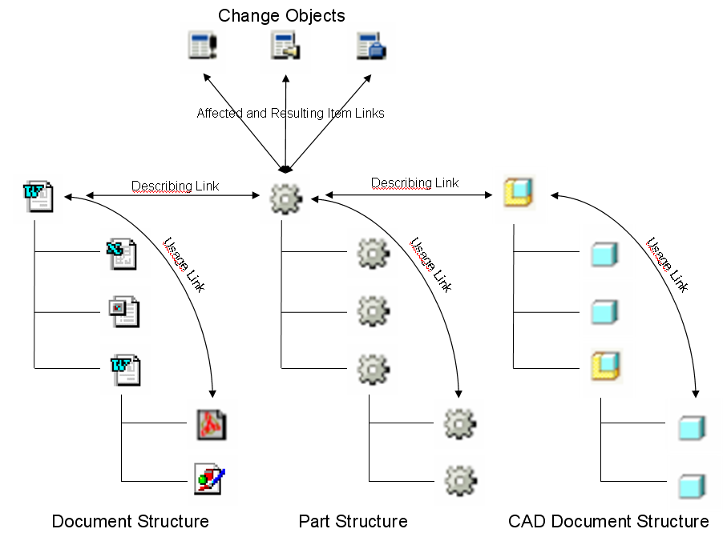
Information Warehouse / Data Model
Explain which objects the systems offers (supports) and what relationships between these objects exist. Is it possible to define attributes on relationships (e.g. an attribute describing the relation between an ECN and each linked part)
Please refer to the RFP Chapter 6

Slide 33
Data Replication
Suggest how Synthes should handle data replication.
What data? Where? Period of time ?

Slide 34
Data Replication
Suggest how Synthes should handle data replication. What data ? Where ? Period of time ?
Wheel Team
Internal Team
Italy
Responsible for wheels
Windchill
Master
Server
Windchill
Replica
Server
Drive Train & Brake Set Team
External Partner
Japan
Responsible for
Crank
Chain
Rear Cogs
Bottom Bracket
Front Derailleur
Rear Derailleur
Brakeset
Brakelevers
Product Team
Internal Team
Company HQ
Connecticut, US
Designers and “Engineer Integrators”
Responsible for
Total bicycle
Frame Handlebars
Windchill
Replica
Server
Web Server
Servlet Engine
Windchill Server
Server Manager
Web Server
Servlet Engine
Method Server
Windchill Replica Server
Server Manager
Method Server
LDAP Database
RDBMS Database
File Vaults
File Vaults

Slide 35
Data Replication
Suggest how Synthes should handle data replication. What data ? Where ? Period of time ?
Benefits
Local upload provides the means for end users to upload content to a local
server rather than directly to the master Windchill server
Improves user productivity by reducing the interaction time for check-ins,
uploads, and the creation of new documents by remotely located end users
Provides access to latest information created at remote sites to all sites
sooner
Enables rapid exchange of content between users located at the same
remote site
Notes:
With Windchill Content Replication in R5, the content files for which remote users need access can be replicated to a server within the LAN environment of the remote users. Because the bandwidth and latency are optimal, the performance for downloading content files to the client is optimal.
As a result, the productivity of remote end users can be increased with the decreased downloading times for documents, because the content files may be downloaded from a nearby location over a fast network connection.
In order to make the proper content available to the users at the remote site, Content Replication Vaulting Rules must be defined to specify what information should be replicated.
In addition, a replication schedule must be created to specify the frequency with which the content will be replicated from the master site to the remote site(s).

Slide 36
Data Replication
Suggest how Synthes should handle data replication. What data ? Where ? Period of time ?
What data?
Heavy Content like MCAD Data and reuse data (standard parts)
Where?
On all locations where the content data is needed and where data is reused
Period time?
Depends on the network band width, e.g. every night replication can be scheduled
Notes:
With Windchill Content Replication in R5, the content files for which remote users need access can be replicated to a server within the LAN environment of the remote users. Because the bandwidth and latency are optimal, the performance for downloading content files to the client is optimal.
As a result, the productivity of remote end users can be increased with the decreased downloading times for documents, because the content files may be downloaded from a nearby location over a fast network connection.
In order to make the proper content available to the users at the remote site, Content Replication Vaulting Rules must be defined to specify what information should be replicated.
In addition, a replication schedule must be created to specify the frequency with which the content will be replicated from the master site to the remote site(s).

Slide 37
Input /Digitising
Explain and/or show the possibilities for data import to the system (files).
e.g. List of suppliers (name, address, status) in an csv-list, standards (ISO, ASTM)
xml files.
Explain how an efficient way to enter scanned data directly into the system
could be realized

Slide 38
Input /Digitising
Explain and/or show the possibilities for data import to the system (files). e.g. List of suppliers (name, address, status) in an csv-list, standards (ISO,ASTM) xml files.
PTC offers the Loadfromfile framework to Load File System Data
Data Load commands require XML object files to be passed as input
The Windchill Loadfromfile framework:
Out of the Box
Available for most Business Objects
Easy to Configure / Tailor to Business Needs, like input from Scanners or occasional loading from other systems.
Scanner Output Files
OOTB Business Loader Framework
Files
Data File
( CSV format)
CSV2XML Conversion
Processing with Windchill Business Information Loader
Saved in Windchill
Data File
( XML format)

Slide 39
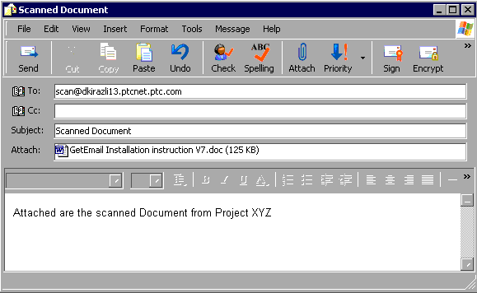
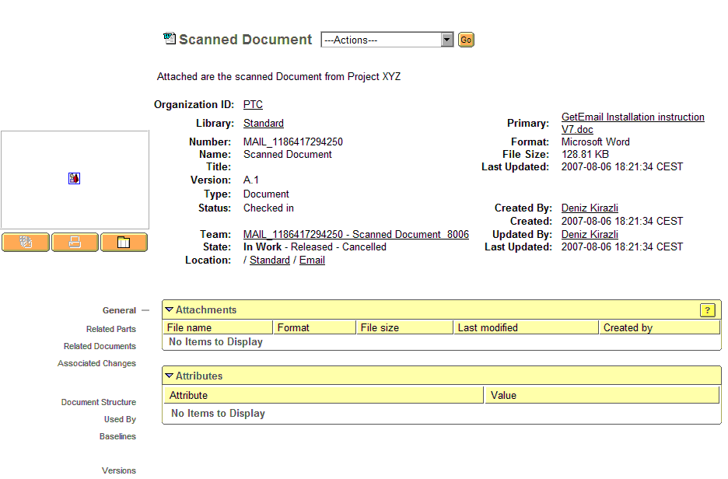
Input /Digitising
Explain how an efficient way to enter scanned data directly into the system could be realized
Windchill provides the possibility to receive
Emails and to add the attached document
as new object in the database

Slide 40
Output-/Plot-/Print-Formats
If printing is performed directly out of PLM: Show how a file is printed and how
access to printers can be restricted or assigned to users
Show how the system automatically generates neutral file formats (pdf, tiff) of
native documents e.g. when a document is released
Show how an administrator can initiate the creation of the neutral file
format manually
Explain and/or show how a selected set of files along with meta data can
exported on an network drive
Explain and/or show how the output queues can be monitored and what
possibilities system administrators have to make changes in the queue.
Explain how the system deals with different paper sizes in US and EU
when printing

Slide 41
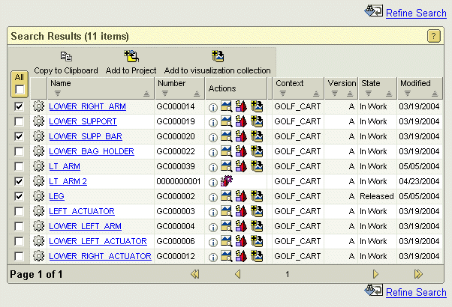
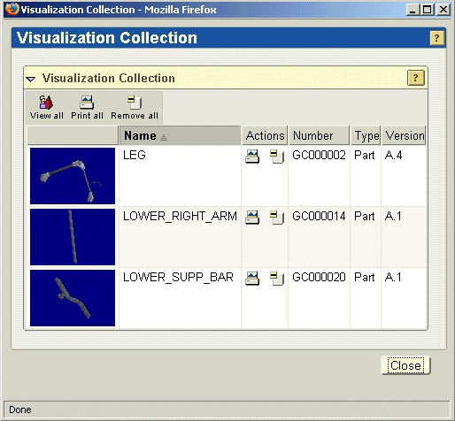
Output-/Plot-/Print-Formats
If printing is performed directly out of PLM: Show how a file is printed and how access to printers can be restricted or assigned to users
Windchill provides the possibility to search for the relevant objects (e.g. documents,drawings or 3D Models), to collect them and to print them all

Slide 42
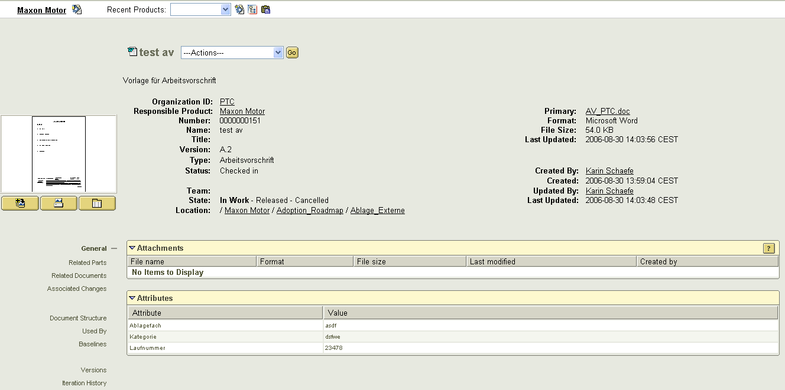
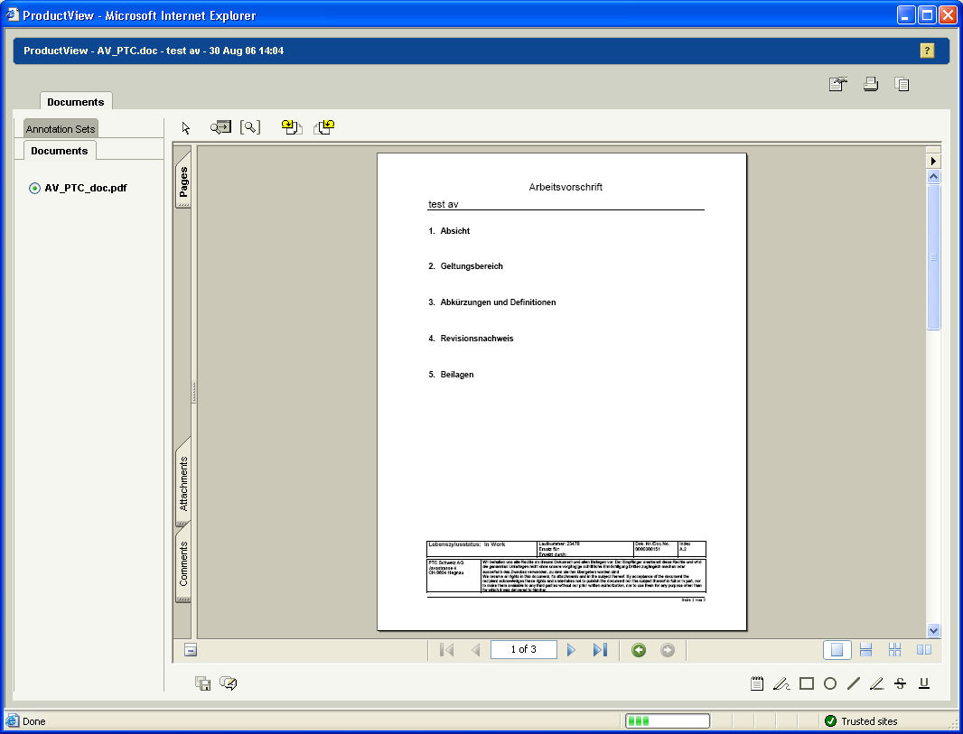
Output-/Plot-/Print-Formats
Show how the system automatically generates neutral file formats (pdf, tiff) of native documents e.g. when a document is released
Windchill provides Out-of-the-box that every document (office document) which is checked in, automatically is converted to PDF as a representation (viewable)

Slide 43
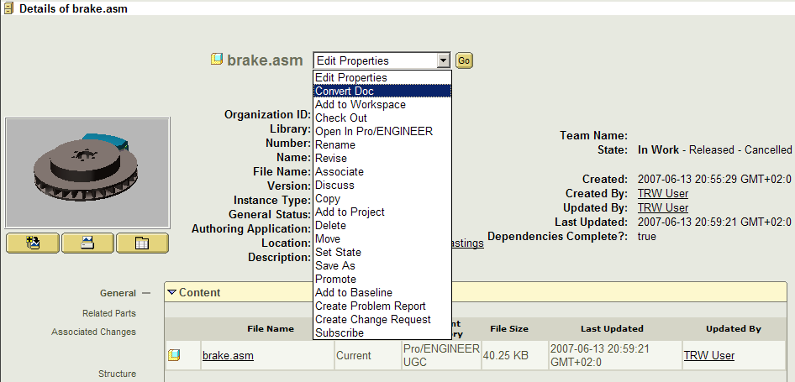
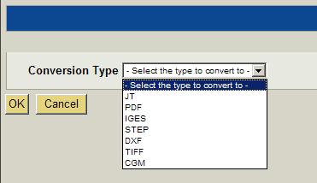
Output-/Plot-/Print-Formats
Show how an administrator can initiate the creation of the neutral file format manually
Another option is to convert 3DModels or drawings to a specific format (JT, IGES, etc) manually

Slide 44
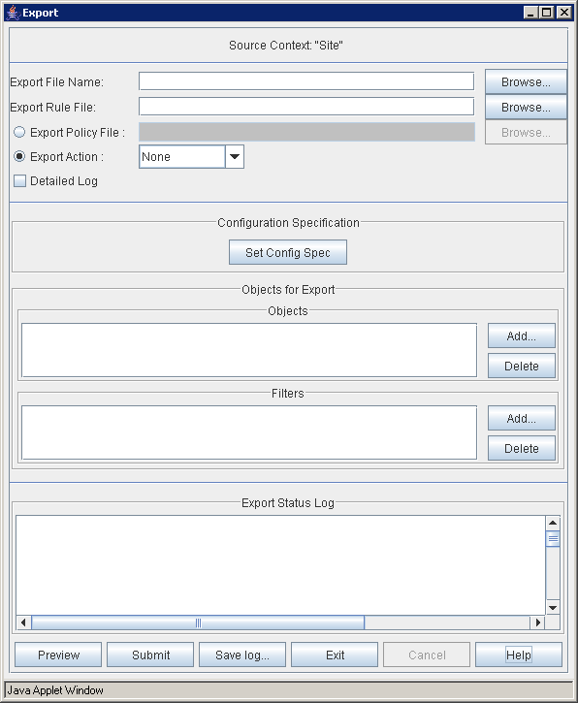
Output-/Plot-/Print-Formats
Explain and/or show how a selected set of files along with meta data can exported on an network drive
Import and Export can assist you in moving complete content and metadata to and from sites by placing the data in JAR files.
Export places all the data held in high-level items in the local database into JAR files on the local file system.
Export allows you to compress the data in any of the following items into a JAR file. Documents that are referenced by other items are included in the export data.
Cabinet and Folder Contents
Product Structure
CAD Document Structure
Product Structure with CAD Documents
Document
Soft Type Definition

Slide 45
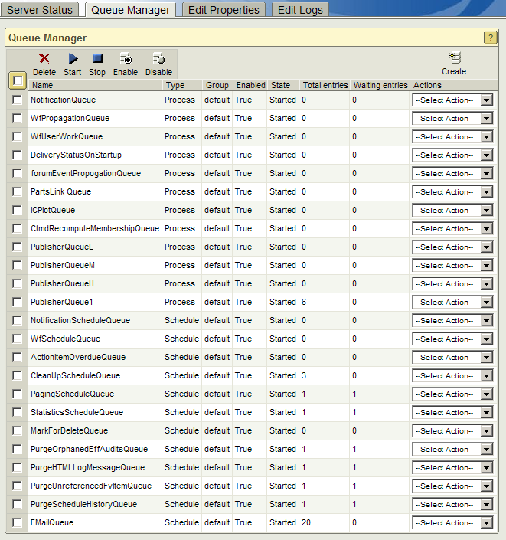
Output-/Plot-/Print-Formats
Explain and/or show how the output queues can be monitored and what possibilities system administrators have to make changes in the queue
Windchill background queues are responsible for many tasks, such as e-mail notifications and life cycle processing.
The Queue Manager oversees the execution of Windchill background queues, allowing you to monitor task execution and queue status.

Slide 46
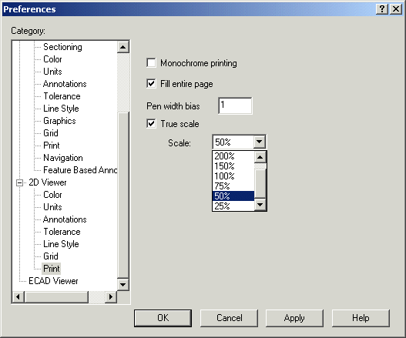
Output-/Plot-/Print-Formats
Explain how the system deals with different paper sizes in US and EU when printing
Printing from Windchill is typically done through ProductView utilizing available printers at the client location.
No additional maintenance for Windchill printing.
Automatically Utilize Local Paper Sizes
Supports Printing to Scale
Supports Document and Drawing Scaling
Supports Batch Print

Slide 47
Miscellaneous Requirements
Show how office document templates are created, how a new life cycle is
created for that document type and how the document template is connected
to the life cycle
Show how predefined lists of values for specific data fields are managed
(e.g. for drop-down list boxes)
Show how default values for data fields can be defined
Explain how the administrator is able to analyse software errors (e.g. trace files,
debugger etc).
Explain how large sets of data can be changed by a system administrator
(e.g. setting 500 documents to status “archived”). How is it possible to create
history entries in that context?

Slide 48
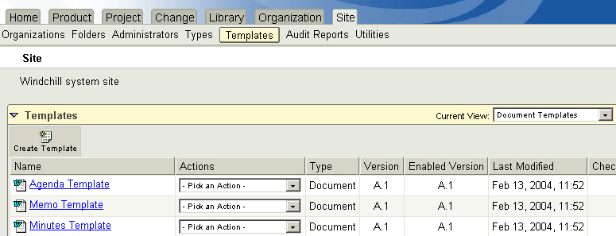
Miscellaneous Requirements
Show how office document templates are created, how a new life cycle is created for that document type and how the document template is connected to the life cycle can change the helpfiles
Choose ‘Document Templates’ from Current View drop-down menu
Download, Create, View, Update, Delete, Save As, Details, Enable, Disable

Slide 49
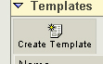
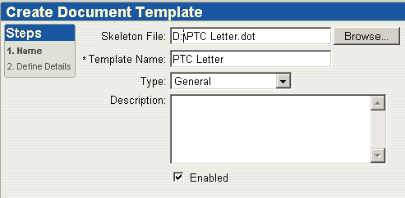
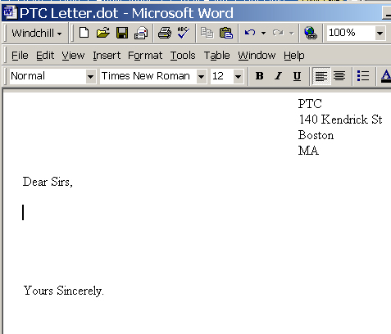
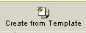
Miscellaneous Requirements
Show how office document templates are created, how a new life cycle is created for that document type and how the document template is connected to the life cycle can change the helpfiles
Document Templates can be used to provide skeleton content files for regularly used documents
Eg. PTC_Letter_Template.dot, Sales Figures Template.xls
Users have the option to ‘Create Document from Template’
Document object pre-populated with skeleton content file. User creates object, downloads skeleton file and edits as required

Slide 50
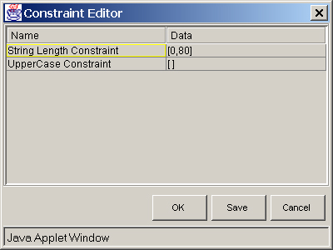
Miscellaneous Requirements
Show how predefined lists of values for specific data fields are managed (e.g. for drop-down list boxes)
Constraints can be applied to attributes to assist user input and ensure correct data
Discrete Set Constraint
Range Constraint
Single Valued Constraint
String Length Constraint
Suggested Values Constraint
Upper Case Constraint
Value Required Constraint
Wildcard Constraint
Multiple Constraints can be applied

Slide 51
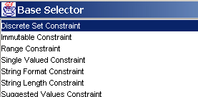
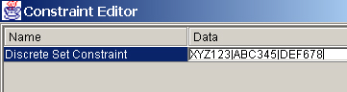
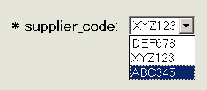
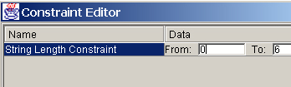


Miscellaneous Requirements
Show how predefined lists of values for specific data fields are managed (e.g. for drop-down list boxes)
Select Discrete Set Constraint
Enter values in Constraint Editor
eg ABC|DEF|GHI
Save and checkin Type

Slide 52
Miscellaneous Requirements
Show how default values for data fields can be defined
Select Discrete Set Constraint
Enter values in Constraint Editor
eg ABC|DEF|GHI
Save and checkin Type

Slide 53

Miscellaneous Requirements
Explain how the administrator is able to analyse software errors (e.g. trace files, debugger etc).
Log files are used to capture exception/error tracebacks and debug tracing messages.
In the first case, log entries are generally infrequent, marking exceptional events.
However, you can enable more verbose logging levels for troubleshooting purposes.
Many packages support the printing of messages during execution to assist you in debugging.
Additionally, log files can be appended or overwritten at each execution.
Output can be sent to both the console and log file, or just the log file.

Slide 54



Miscellaneous Requirements
Explain how large sets of data can be changed by a system administrator (e.g. setting 500 documents to status “archived”). How is it possible to create history entries in that context?
Windchill provides the functionality to select a large set of data and to “promote” to a different status
The History is automatically written to the LifeCycle History

Slide 55
User Interface
Show how system administrators can change the helpfiles or create own
additional helpfiles
Show how users can switch between languages of the interface and of the data.

Slide 56
User Interface
Show how system administrators can change the helpfiles
Windchill solutions deliver online help in the WebHelp format provided by the eHelp Corporation. WebHelp is a cross-browser, HTML-based format that provides a three-pane window. The top pane contains buttons to select navigation
features, the left pane contains the table of contents and a search form for navigating and searching the help system; the online help content appears in theright pane.
WebHelp is a cross-browser format that uses dynamic HTML (DHTML) to display the table of contents and full-text search navigation tools. The following table summarizes the customizations you can make in WebHelp:
Customization | DHTML
Edit, add, and delete topic content. | Yes
Edit existing table of contents entries/links and search results/links. | Yes
Delete table of contents entries/links and search results/links. | Yes
Add table of contents entries and links. | Yes
Change background color of topics and make other basic topic style changes. | Yes

Slide 57




User Interface
Show how users can switch between languages of the interface and of the data.

Slide 58
Workflow Management
Show how system defined workflows can be created and controlled by the
administrator and how to apply them to different object types at various release
levels.

Slide 59

Workflow Management
Show how system defined workflows can be created and controlled by the administrator and how to apply them to different object types at various release levels
Capabilities
Graphical process editor to easily define and view processes
Graphical process execution monitor and manager
Nested process support to facilitate process reuse and definition
Nested ad hoc activity definition to accommodate dynamic processes
Process blocks to manage process complexity
Team-based role resolution and role, user, group variables
Activity based access control to avoid object access conflicts
Electronic signatures and signature records
Interfaces to invoke and interact with applications and servers
Email notification delivery
Event triggers and timers
Capability to import, export and manage process templates
Notes:
Graphical process editor—The editor consists of a graphical pallet of tools and a process panel that supports the quick creation and editing of complex processes. Human and automatic activity elements are placed in a process panel and connected with links to define the process flow and to control routing. The editor includes the ability to drag connected elements, copy, paste, align, label and export components.
Graphical process monitor and manager—The process manager provides both a graphical view of the process and indicates which activities are running, have completed and which have not started. Process administrators can manage the process and can force a process or activity to completion or skip an activity step.
User-tailored worklist views—Workflow activity workitems are delivered to an HTML worklist that each user can tailor to determine which task attributes to display in which order and how to group and sort the items. Each user can define a set of unique worklist views that they can then recall to quickly display the key work reports of interest.
Email task delivery—Any task can be configured to be delivered by email as well as to the worklist. Email task notifications provide a complete process context and links to all process related information as well as the task form.
Nested process support—Process definitions can include references to other process templates that can be executed synchronously or asynchronously with the parent process. Process references (sub processes) can be nested arbitrarily deep.
Nested ad hoc activity definition to accommodate dynamic processes—Any activity can be defined to allow it to spawn additional activities on the fly. This is needed to support work breakdowns and forwarding. Each spawned activity can itself spawn one or more activities.
Process blocks—Process block can be defined to collect a set of functionally related activities in a single process to abstract the behavior and reduce the top level complexity.
Dynamic thresholds—Processes can define thresholds that ensure that a number of optional tasks that are started, all will complete before a subsequent task is started.
Team-based role—Process participation can be described by roles, users, groups, actors (such as the process creator) and teams. Variables can be defined for each of these types. A team object can be defined to associate users and groups with each activity role for a process instance.
Activity based access control—Access to objects to view and edit can be controlled in the workflow definition to assure that the assignee has the appropriate access to complete their assigned task.
Electronic signatures and signature records—Any task can enforce a forced authentication at task completion and can create the complete signature history record to meet corporate or government regulatory requirements.
Interfaces to applications and servers—The workflow system supports automated activities to invoke external applications and to send information to and to receive information from other servers.
Email notification delivery—Emails can be automatically delivered by a workflow process. These emails can include dynamic information and URL links.
Event triggers and timers—A workflow process can emit events and listen for events to synchronize with other processes and to trigger actions.

Slide 60
Workflow Management
Show how system defined workflows can be created and controlled by the administrator and how to apply them to different object types at various release levels
Benefits
Reduce development costs by reducing management overhead
Reduce time to market by speeding development execution
Improve quality by ensuring that no essential steps are missed
Reduce rework by ordered development activities
Efficiently and automatically manage routing of tasks
Provide full record of process participation for verification
Provide collaborative process space to share comments,
links and documents from all participants
Automatically manage life cycle state changes
Notes:
Workflow Overview
Workflow is a powerful collaboration tool that automatically executes and manages business processes. The Workflow Management Coalition (WfMC) definition of workflow is: “The computerized facilitation or automation of a business process in whole or in part.” Business information, tasks, and documents are passed between participants in activities in a workflow process. A workflow process consists of a well-defined set of activities, participants and rules to accomplish business goals. A workflow participant is broadly defined as a person, group, role or resource assigned to participate in a workflow activity. Workflow is a powerful collaboration tool that automatically executes and manages business processes. The Workflow Management Coalition (WfMC) definition of workflow is: “The computerized facilitation or automation of a business process in whole or in part.” Business information, tasks, and documents are passed between participants in activities in a workflow process. A workflow process consists of a well-defined set of activities, participants and rules to accomplish business goals. A workflow participant is broadly defined as a person, group, role or resource assigned to participate in a workflow activity. Workflow activities may be accomplished by human participants or automatically by system participants.
A workflow management system supports the definition, management and execution of workflows. Workflow Management is a rapidly evolving technology that is increasingly exploited by businesses in a variety of industries. Its primary application is the automation of processes involving combinations of human and machine-based activities—particularly those involving interaction with information applications and tools.
Windchill Workflow provides a foundation for enterprise wide collaboration and delivers enterprise productivity gains. Workflow builds upon and extends the Web-centric Windchill architecture foundation and supports the suite of applications that make up Windchill’s enterprise information management system.
This document describes the architecture and approach behind Windchill’s Workflow product.
Workflow Value Proposition
To remain competitive, businesses must continuously improve their processes. The automation of repetitive business processes can provide large productivity leaps and improvements in quality.
The value of a workflow system is that it ensures a process is followed and is automatically managed. A workflow system ensures that each task and the required data are delivered to the appropriate participant at the right time and the participant knows what is expected and when it is expected. Furthermore, a workflow system provides records of all the activities in a running or completed workflow process. This information is used to monitor the progress of a running process, manage a running process, and to review the outcome of a completed process. The information associated with completed processes may be used to develop process metrics to aid in identifying process bottlenecks and to continuously improve business processes.
Workflow Components
A workflow system consists of three principal components:
The workflow definition system – This system is responsible for defining the workflow process and saving the process definition as a process template.
The workflow runtime system – This system is responsible for executing a defined workflow process. This includes delivering items to a participant worklist, invoking applications, initiating subprocesses, and interacting with directory services, calendar systems and email systems.
Workflow monitoring and reporting system – This system is responsible for tracking the workflow events and monitoring a running or completed workflow. Information such as activity duration, execution time, and longest workitem can be obtained through this system. This information can then be used to identify bottlenecks in a process and to develop solutions for process improvement.

Slide 61


Workflow Management
Show how system defined workflows can be created
Objects are associated with a life cycle and a life cycle phase or gate is optionally associated with a process
Life cycles define object phases
Show current phase
Control access for each phase by role
Associate workflow process for each phase
Define criteria for moving from phase to phase
Capture phase history
Workflow enforces business processes
Workflow delivers the object, instructions and related material to required participants
Workflow manages progression through life cycle phases
Workflow captures history of activities
Notes:
Object, Life cycle & process integration
The tight integration between business objects, life cycles and process is a key strength of the Windchill product life cycle management solution. The relationships between these key components provides a robust environment for managing and communicating the state of key business information.
How are objects, life cycles and process related in the Windchill system?
When an object is created, it is placed in the first phase of its associated life cycle. If there is a workflow process associated with this first phase, then this workflow process is initiated. This workflow process may be defined to control the transition to all subsequent life cycle phases. For example, when a particular approval process defined in the workflow is completed, the life cycle may be automatically moved to a released state. This release state may prohibit any following changes to a specific version of an object.

Slide 62
History Management
Explain and/or show how the change history of objects and object relations are
stored (e.g. history entry created when a part is linked to a document). How are
entries protected from deletion?
Explain and/or show how to configure system to capture events for auditing.
Show how history can be displayed and printed.
Explain and/or show the possibilities users / administrators have to create
history entries?

Slide 63

History Management
Explain and/or show how the change history of objects and object relations are stored (e.g. history entry created when a part is linked to a document). How are entries protected from deletion? How history can be displayed and printed.

Slide 64


History Management
Explain and/or show how to configure system to capture events for auditing. Show how history can be displayed and printed.
Audit Reports can be used to record and report System and User events for auditing and tracking

Slide 65

History Management
Explain and/or show how to configure system to capture events for auditing. Show how history can be displayed and printed.

Slide 66


History Management
Explain and/or show the possibilities users / administrators have to create history entries?
Windchill provides Out-of-the-box the listed history entries

Slide 67
Check-Out / Check-In
Show how an object is reserved (and therefore protected from modification) when
checked out
Show how a system administrator is able to unlock that reservation
Explain or show how local copies of files are handled. Are the copies deleted after
check-in?

Slide 68

Check-Out / Check-In
Show how an object is reserved (and therefore protected from modification) when checked out
Check out locks a document in order to prevent the document from being updated by others.
When you check out a document, a working copy of the original document resides in the Checked-Out Work table on the Home tab. Objects which are checked out cannot be checked out by other users.

Slide 69


Check-Out / Check-In
Show how a system administrator is able to unlock that reservation
Object is checkout by a user.
The administrator is able to unlock the data.

Slide 70


Check-Out / Check-In
Show how a system administrator is able to unlock that reservation
The administrator is able to select the data and to make an unlock

Slide 71


Check-Out / Check-In
Explain or show how local copies of files are handled. Are the copies deleted after check-in?
Windchill provides the functionality during check-in process to select the option to remove the content from local disk

Slide 72

Programming Interface
Explain how an external application can access PLM functionality through an API. Give examples of third parties which offer software which use that kind of interface

Slide 73


Set-up Routines
Show the defaults which can be assigned to users at user login (e.g. correct user language or other preferences)
User preferences can be set throughout Windchill. Out of the box, users can set preferences for their own workstations, and administrators can set preferences for each scope, where the preferences can be available to all lower level scopes.

Slide 74
Software
Explain what parts of the required PLM functionality would be made available using third party software and how this software interfaces with the PLM system

